Slide 1
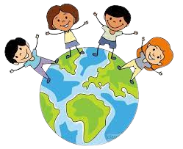



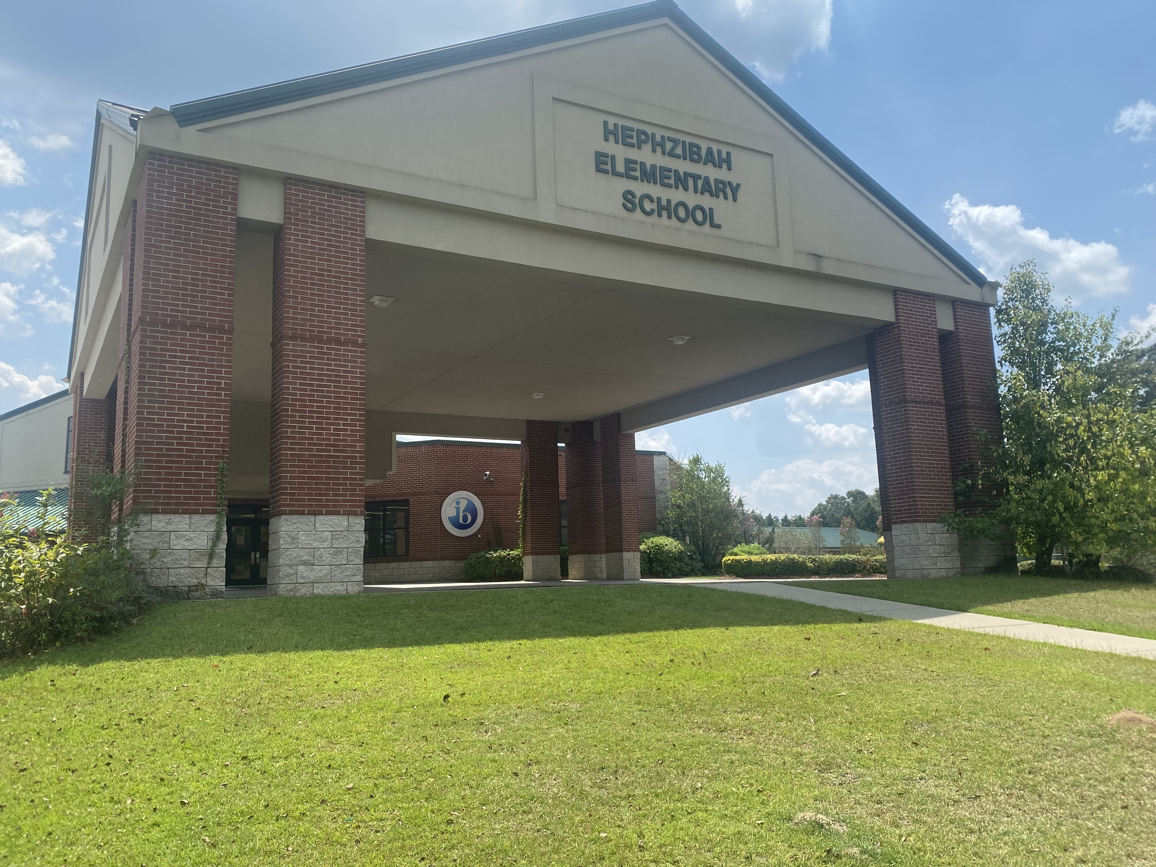


HEPHZIBAH ELEMENTARY SCHOOL
School History
Hephzibah Elementary School (HES) is a public school located in Hephzibah, Georgia, a rural community approximately fifteen miles south of Augusta, Georgia. The school is one of 28 elementary schools within the Richmond County School System. The history of HES dates back to the early 1840’s when the community of Brothersville (renamed Hephzibah) was settled and a field school was established. Through the years, HES has gone through many changes. The current school opened its then state-of-the-art building in August 2001. HES presently serves 580 elementary students in grades Pre-K thru fifth grade.
Mission
Building a world-class school system through education, collaboration and
innovation.
A “Koala-ty” School
The mission of Hephzibah Elementary
School is to develop caring, compassionate, and responsible students who are life-long
learners, committed to seeking knowledge and understanding of other people and the world around them.
Title I Information
Hephzibah Elementary is a Title I school. The
Parent Resource Center is open daily from
8:20 a.m. - 3:10 p.m.
Special Programs
First in Math
Math Team
Reading Bowl Team
Reading Buddies
FitnessGram
Track Team
ArtsNow
Release Time
Spanish
Strings Program
Student Morning News Program
Learners to Leaders Mentor Program
Join us for Open House in November!
Take a tour of the building
Meet the Head of School
Dr. Josh Workman, Principal
Mrs. Stephanie Spencer, Assistant Principal
2542 Hwy 88
Hephzibah, GA 30815
Phone (706) 592-4561
http://heph-elem.rcboe.org

Slide 2

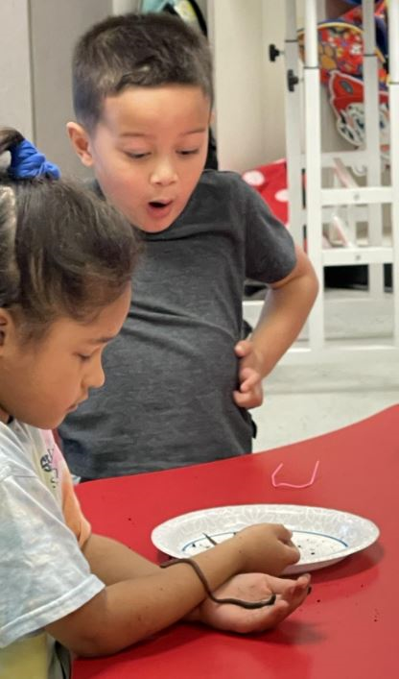
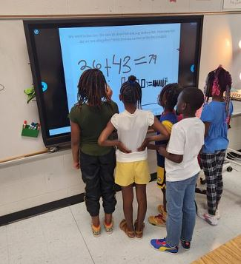
Hephzibah Elementary School is an authorized* IB World School for the Primary Years Programme (PYP). IB World Schools share a common philosophy – a commitment to high quality, challenging, international education that Hephzibah Elementary School believes is important for our students.
There are six transdisciplinary themes that permeate the
The International Baccalaureate Mission
The International Baccalaureate aims to develop inquiring, knowledgeable, and caring young people who help to create a better and more peaceful world through intercultural understanding and respect.
The Primary Years Programme (PYP) is a curriculum framework for young learners aged 3-12 designed by the International Baccalaureate (IB). Founded on philosophy that recognizes a child’s natural curiosity, creativity, and ability to reflect, the PYP generates a stimulating, challenging learning environment to nurture those assets and foster a lifelong love of learning in every child. The PYP, like all IB programmes, is transdisciplinary, meaning students learn across subject areas while investigating big ideas.
The IB Primary Years Programme
IB PYP Programme:
Who we are
An inquiry into the nature of the self, beliefs and values.
The six subject areas identified within the IB Primary Years Programme:
Where we are in place and time
An inquiry into orientation in place and time, personal histories.
Language, including World Languages
Science
Arts
Mathematics
Social Studies
Personal, Social and Physical Education
How we express ourselves
An inquiry into the ways in which we discover and express ideas.
Addresses students’ academic, social, and emotional well being.
Encourages students to develop independence and to take responsibility for their own learning.
Supports students’ efforts to gain understanding of the world and function comfortably within it.
Helps students establish personal values as a foundation upon which international-mindedness will develop and flourish.
*Only schools authorized by the IB Organization can offer any of its four academic programmes: the Primary years Programme (PYP), the Middle Years Programme (MYP), the Diploma Programme (DP) or the Career-related Programme (CP).
For further information about the IB and its programmes, visit http://www.ibo.org.
How the world works
An inquiry into the natural world and its laws, the interaction between the natural world and human society.
How we organize ourselves
An inquiry into the interconnectedness of human- made systems and communities.
Sharing the planet
An inquiry into rights and responsibilities in the struggle to share finite resources with other people and other living things.

